Slide 1
Power Request
Song Pan
2017-1-19

Slide 2
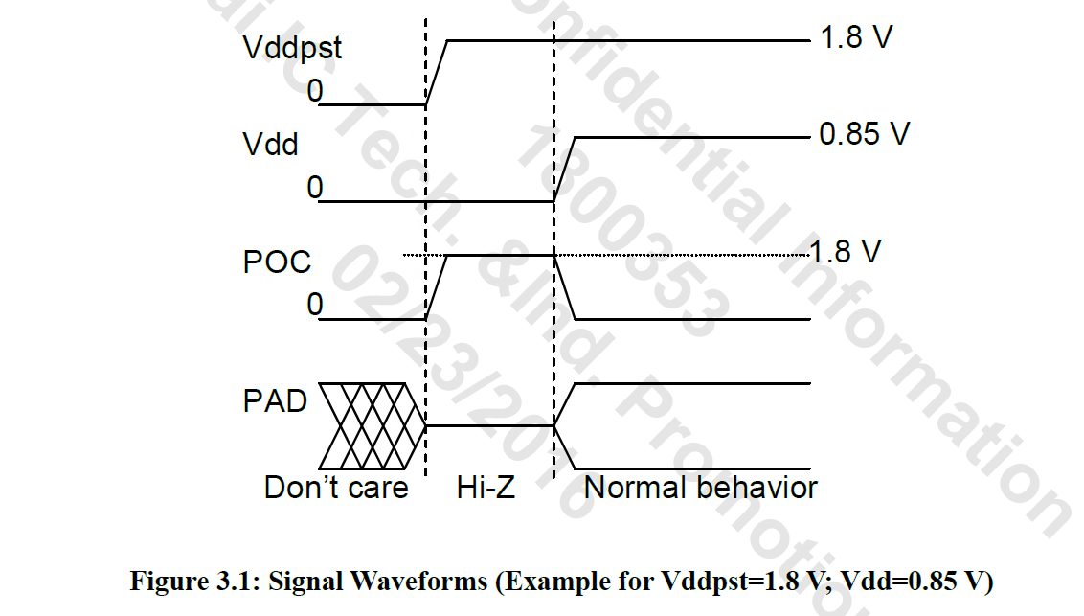
TSMC 1.8v IO Power Up

Slide 3
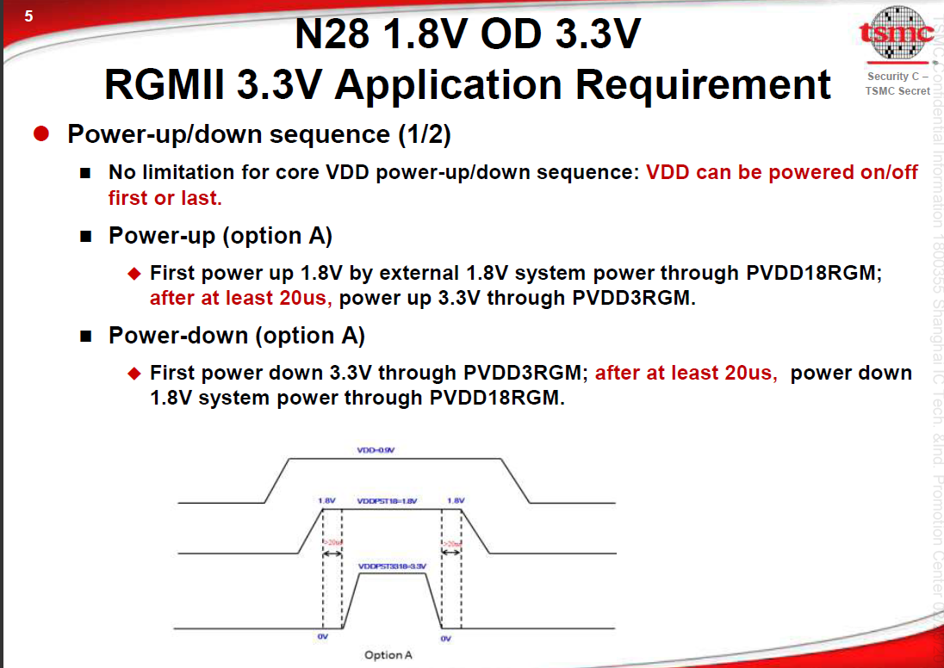

Slide 4
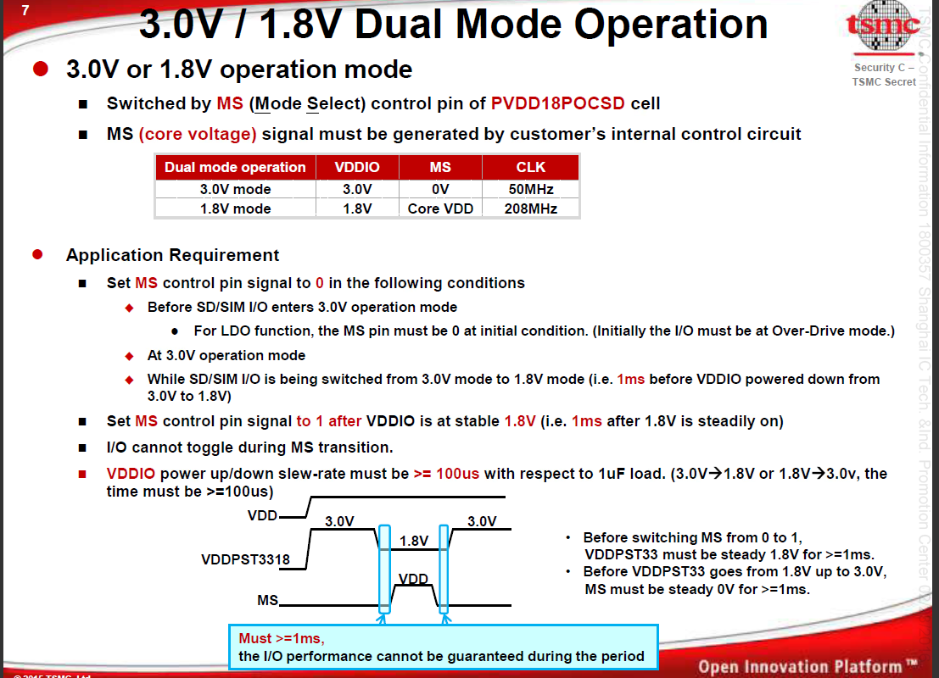

Slide 5
voltage name | voltage value | IP name | Current(mA) | RTP5901 Power / Voltage / Iout / Sequence
DVDD_0v9 | 0.9v |  |  | DC1 | 0.9V | 2.5A | 3
VDD1v8 | 1.8v | TSMC IO /ABB Analog/MIPIx8/HDMI/TYPC | 188.37 | LDO5 | 1.8V | 0.3A | 1
VDD3v01v8 | 3.0v/1.8v | TSMC SD/SIM IO | 72 | LDO2/ LDO4 | 1.8V/ 3.0V | 0.2A | 4
VP3v31v8_PCIE | 3.3v/1.8v | PCIEx2 | 43.3 | LDO3 | 3.3V | 0.35A | 5
VDD3v3 | 3.3v | TSMC RGMII IO/HDMI/TYPC | 36.61 | EXTEN | 3.3V |  | 2
DVDD1v0_A7 | 1.0v | A7 |  | Discrete/ DC2 | Discrete FB Adjust 1.0V | 2A | 2
DVDD1v0_CEVA | 1.0v | CEVA |  | DC2
VDDQ_DDR | 1.5v (DDR3) 1.35v (DDR3L) 1.2v (DDR4) | DDR |  | DC3 | DC3SET 1.5v 1.35v 1.2v | 1.2A | 5
VSYS_3V3 |  |  |  | DC4 | 3.3V | 1A | 0

Slide 6
